Slide 1
Introduction to Mycology 7/14: SPORES

Slide 2
Announcements
Spore prints did not work out ☹
  Let me know if you’d like to do it on your own – I can give you general guidelines and it’d be really fun!
Once again, if you have any comments or critiques on the material I cover please let me know!

Slide 3
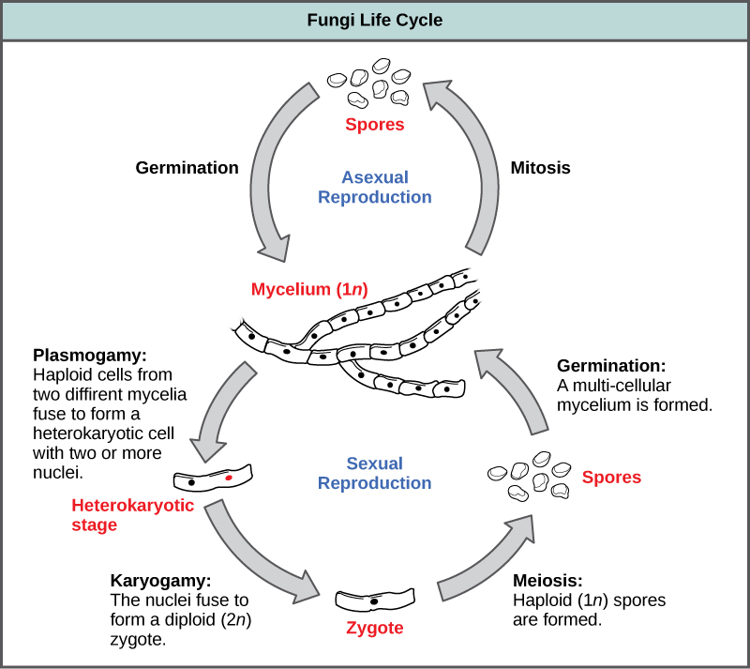

Slide 4
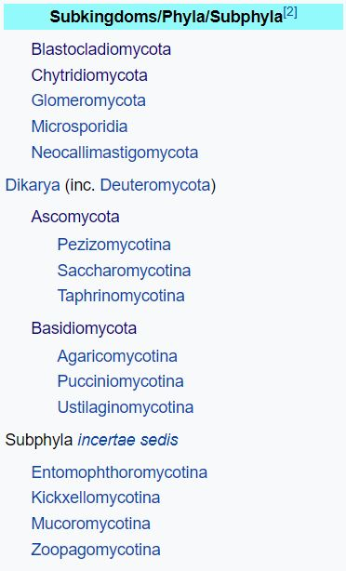
What are spores?
“Microscopic reproductive structure that lack an embryo and are specialized for dispersal/dormant survival”
Many different types – typically for every classification of fungi

Slide 5
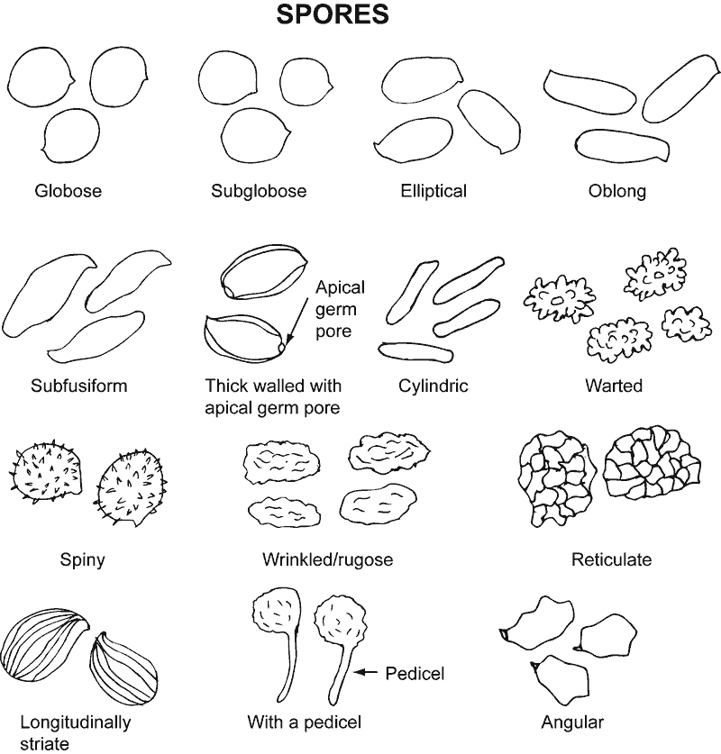
Notes:
I am only going to touch upon the most common types of spores, as there are too many to explain them all. But typically, most fungal spores can be sorted into two categories: (next slide constitutive dormancy, and exogenously imposed dormancy.

Slide 6
Constitutive Dormancy + Exogenously Imposed Dormancy

Slide 7
Constitutive Dormancy
Spores require a period of aging beforehand, or have a specific activation trigger (heat shock/chemical treatment
Spores are typically contained within either asci or basidia – sexual reproduction
Eventually become competent by aging, but can geminate at any time depending on the triggers
Notes:
Draw/talk about asci/basidia on the chalkboard w/ post maturation stuff

Slide 8
Ecology of constitutive dormancy
Environmental triggers:
ACID
FIRE
Notes:
Draw about acid and fire on the chalkboard

Slide 9
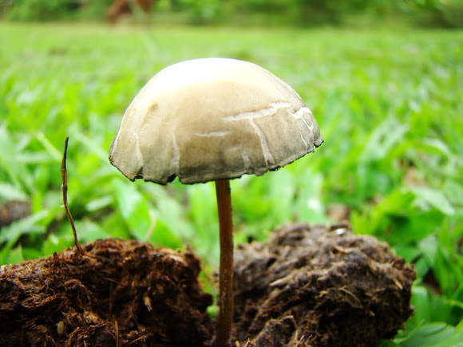


Slide 10
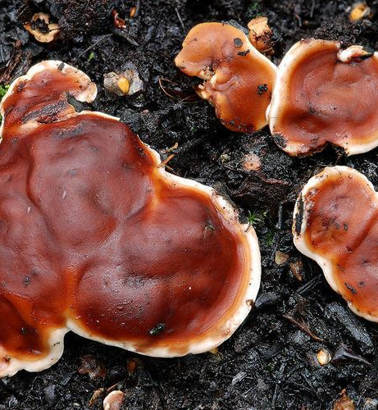
Rhizina undulata (pyrophilic fungi)
Infects trees that are replanted in places that have had serious fires
Foci of infection corresponds to sites where trash from trees were gathered and burned
Ascospores are heat activated around/beneath the fires
  Fungus grows as a saphotroph on the stumps, produces mycelial cords that infect newly planted trees

Slide 11
Exogenously Imposed Dormancy
Remains dormant if in an unsuitable environment, otherwise germinates readily
Spores can be held dormant for long periods of time, as long as the conditions are not suitable
Spores produce by themselves – asexual reproduction
Notes:
Essentially the opposite of constitutive, in which they wait to germinate in unsuitable conditions
Draw on board about germination
And so, why does this happen? Why do these specific types of fungi wait until the environment is perfectly suitable for them to begin to germinate?

Slide 12
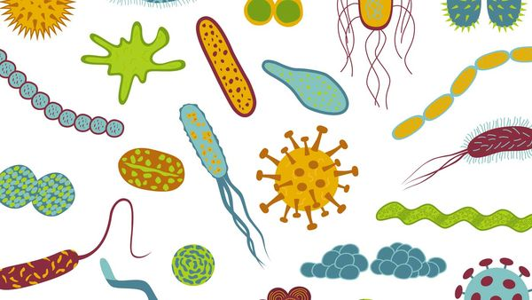
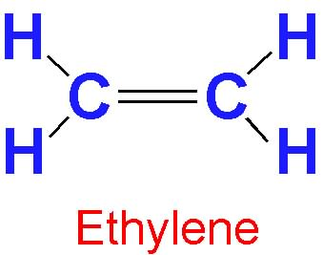
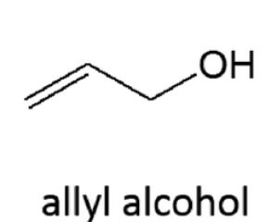
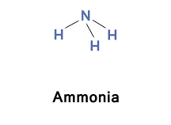
Fungistasis: nutrient deprivation
Microbial-induced phenomenon!
  The less microbes, the better: when there are large amounts of microbes present in the soil, the spores cannot germinate
  Caused by nutrient competitions -> not any specific inhibitor… unless…
    Small part: germination inhibitors in soil, but not the main reason

Slide 13


Lockwood 1977
Spores can germinate in water, but not certain soil
The mechanism of hydration!
Why is this?
Spore leaks nutrients in their immediate environment
Nutrients are metabolized by microbes
Tells the spore that it isn’t time to germinate yet, resulting in inhibitive feedback

Slide 14
Spore Dispersal
Self dispersal (coprophilous fungi)
Insect dispersal
Air-borne dispersal

Slide 15
Self dispersal by coprophilous fungi
Develops high pressure
Wall between sporangium and vesicle breaks down by enzymes
Vesicle suddenly raptures, propelling sporangium (travels far, ~2m)
Mucilage sticks spore on surface it lands
Spores are released, can be spread by other agencies
*Phototropic structure: light signals the direction at which the spore should be released
Notes:
Draw diagram on the board

Slide 16
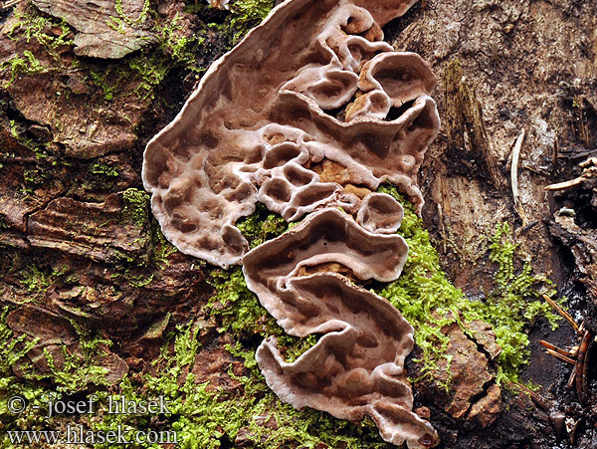
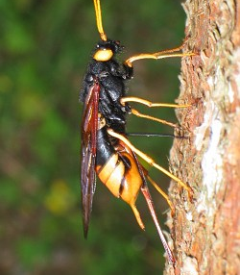
Insect dispersal
Wood wasps lay eggs in the wood of dying moribund trees, larvae eat rotting wood
Some species inject eggs into healthy trees and introduces Amylostereum areolatum
  Growth of fungi dries and kills the wood – commensalism
  Some can be mutualistic – fungus grows in yeast phase in wood wasp’s mycangia (spore pouch), gives nutrients to them

Slide 17
Air-borne spores: Three Steps
Spore
liberation (take off)
Spore
dispersal (flight)
Spore
deposition (landing)

Slide 18
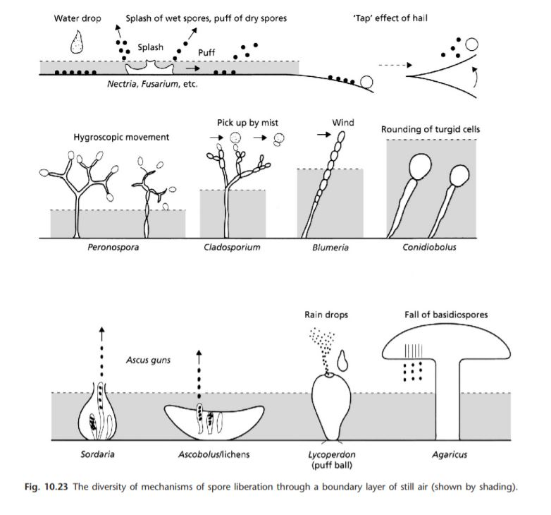
Take off
Notes:
Write about boundary layer on the board

Slide 19
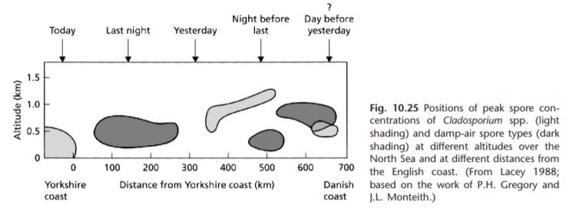
Flight
Important characteristics of spores:
  Resistance to desiccation, which are caused by hydrophobins
  Resistance to UV rays depending on the fungi pigment
Notes:
How they are able to fly for long periods of time
More pigmented fungal spores can last longer and travel further on sunny days
Dessication = dryness
Hydrophobins essentially protect everything on the inside

Slide 20
Landing
Sedimentation: settle out of the air in calm conditions
Wash-out: rain – spores become incorporated in the raindrops
Impaction: air is deflected around an object, makes it carry spores

Slide 21
Landing: Impaction Principles
1. At any given airspeed, the larger (heavier) spores have more chance of impacting
2. As air speed increases, progressively smaller spores can impact
3. As the size of the receiving object increases, the deflection of air is greater and reduces chance of impaction
Notes:
Draw diagram on the board
Air deflection – spore will just bounce off instead – a physics thing that you can look up if you’re interested

Slide 22
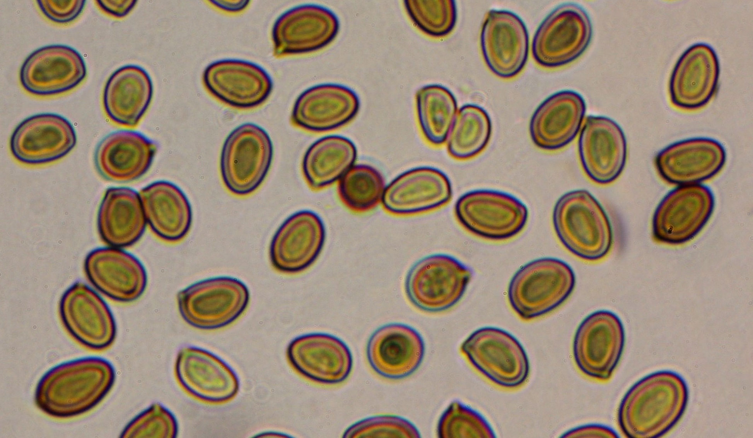
Spores in the respiratory tract
Humans are a natural spore trapping device because the particles are so small -> similar to pollen (why we have allergies!)

Slide 23


Slide 24
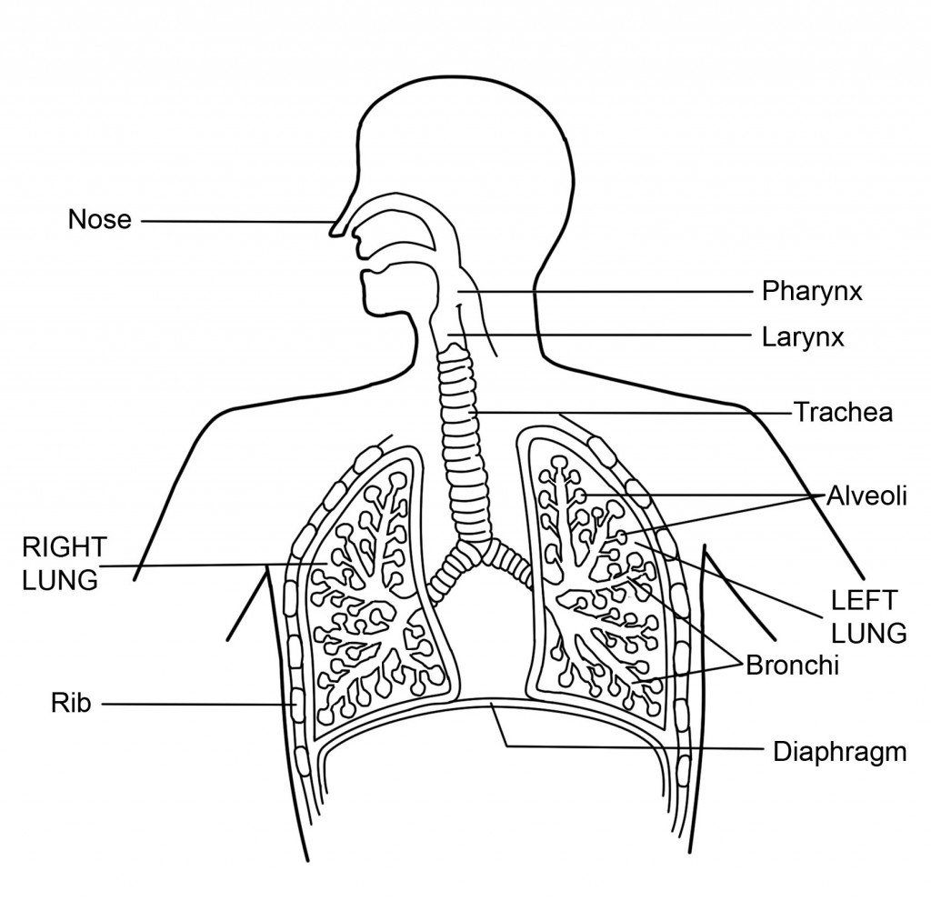
Nose hairs are narrow and covered in mucilage, which intercepts larger fungal spores and pollen grains (impaction)
Spores
Smaller spores are carried into lungs, reach bronchi and alveoli. Many are expelled, but other settles into the mucosal membrane by sedimentation in between inhales and exhales
After each breath, air speed is fastest in nose, trachea, and main bronchi. Spores enter the respiratory system.
Once in alveoli, they are typically engulfed by a phagocyte
Once in upper respiratory system, ciliated epithelium sweeps mucus upwards and removes particles

Slide 25

So, could something like The Last of Us really happen?
Answer: probably not, our bodies have enough expelling mechanisms to prevent spores from wreaking internal havoc
So… no need to be scared of that happening anytime soon

